Slide 1

CAMASL Camera-Assisted Machine Learning for American Sign Language
Final Year Project – Sean Conroy
Bachelor of Engineering (Hons) – Atlantic Technological University

Slide 2
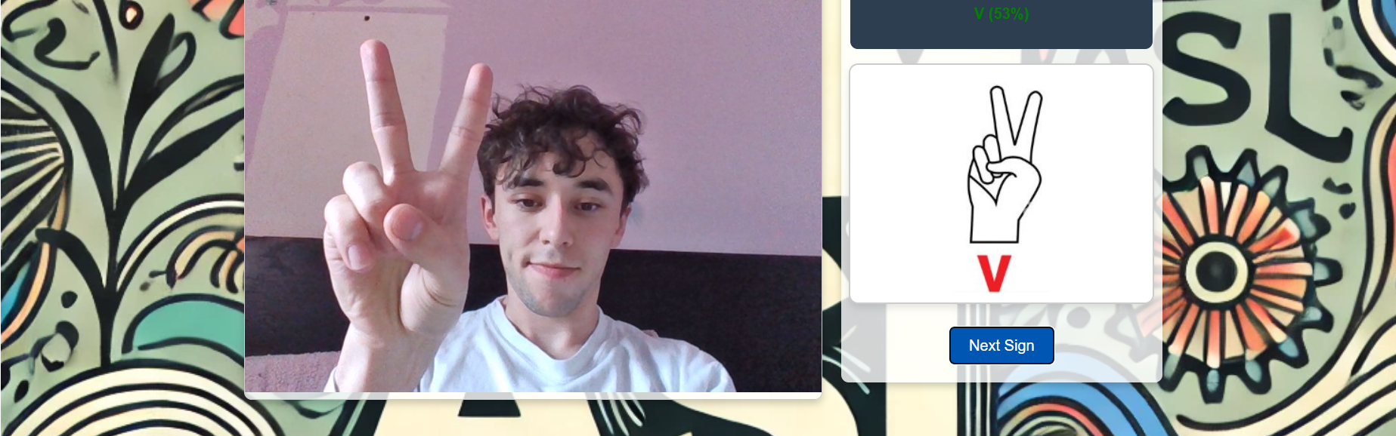
Project Overview
Goal: Real-time ASL learning platform using only a webcam
Problem: Lack of interactive, accessible ASL tools
Solution: ML-based gesture recognition through a web application

Slide 3
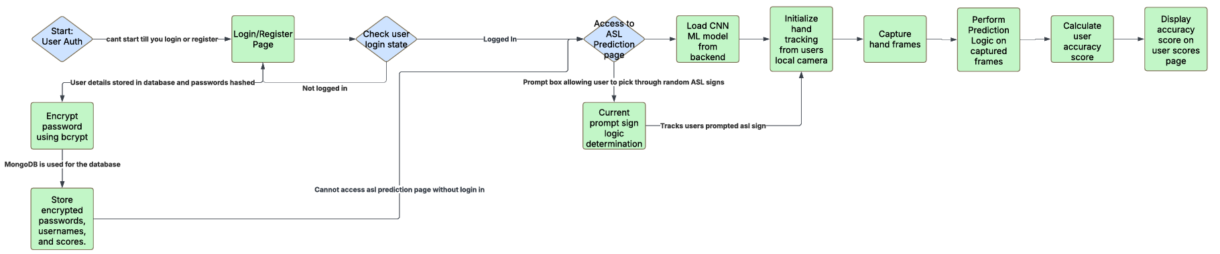
System Architecture Overview
Frontend: React
Backend: FastAPI + TensorFlow
Hand Tracking: MediaPipe
Database: MongoDB Atlas

Slide 4
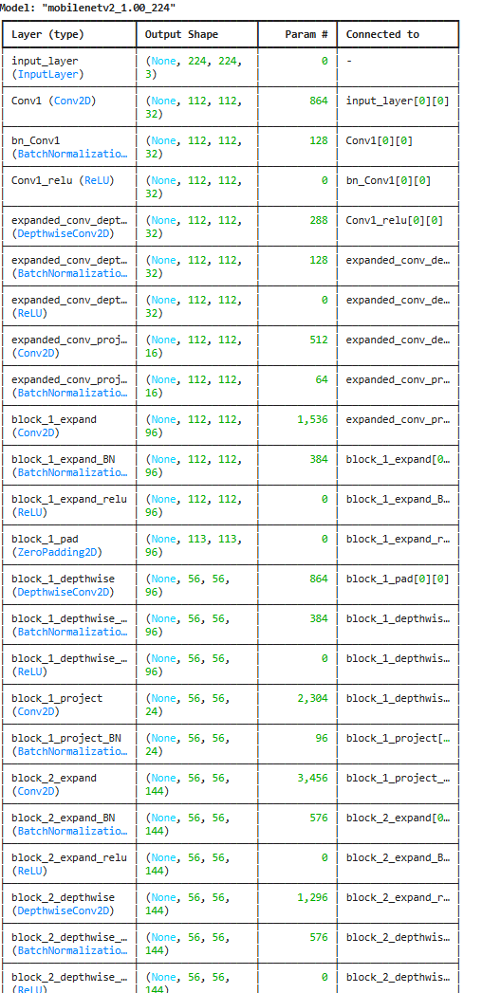
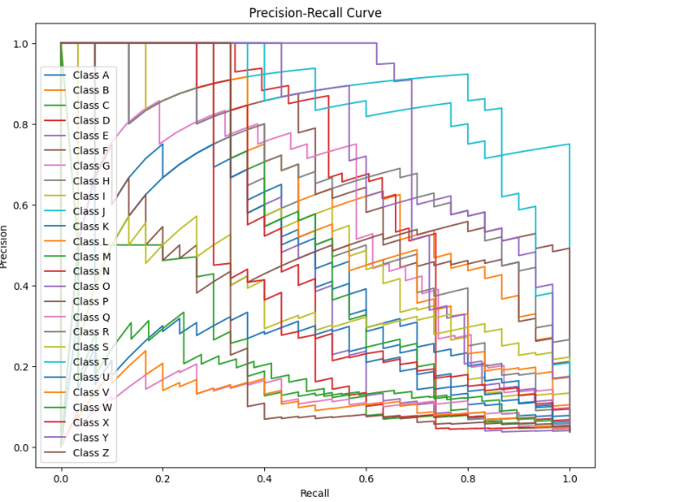
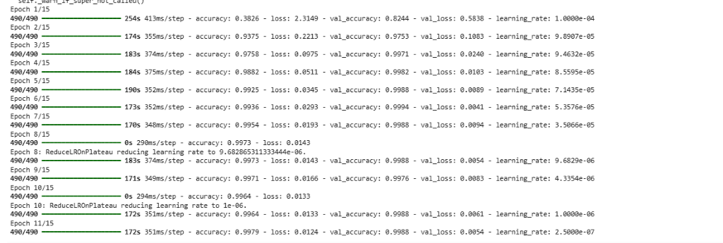
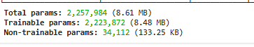
Machine Learning Model
MobileNetV2 fine-tuned for ASL gestures
Lightweight, fast inference
Metrics: Accuracy, Precision, Recall, F1-score

Slide 5
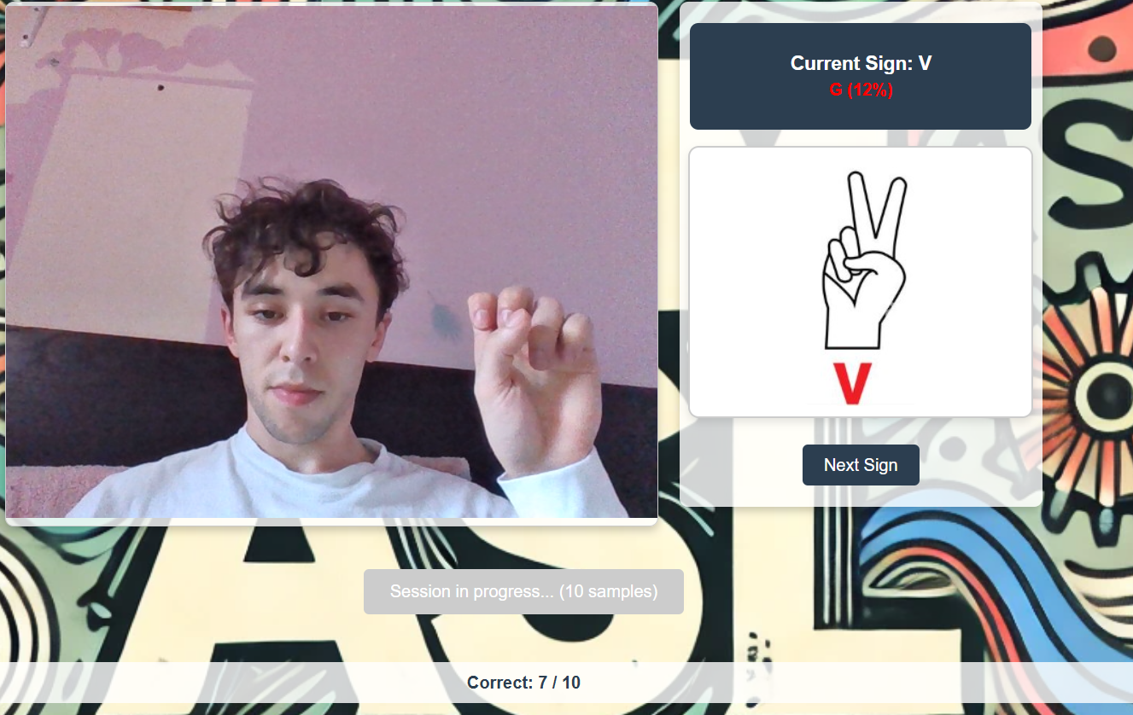
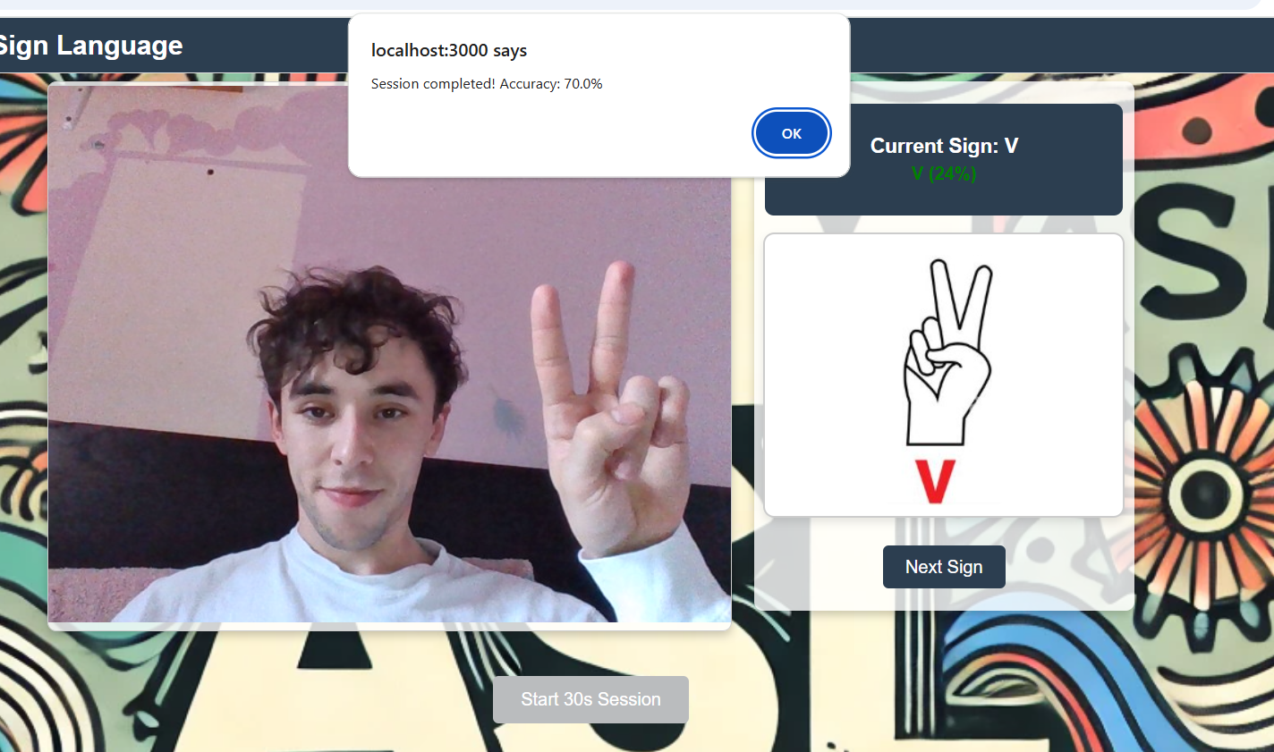
How the Application Works
User login
Random sign prompt displayed
Webcam frame sent to backend
Hand detection → Model prediction → Scoring over 30 frames

Slide 6
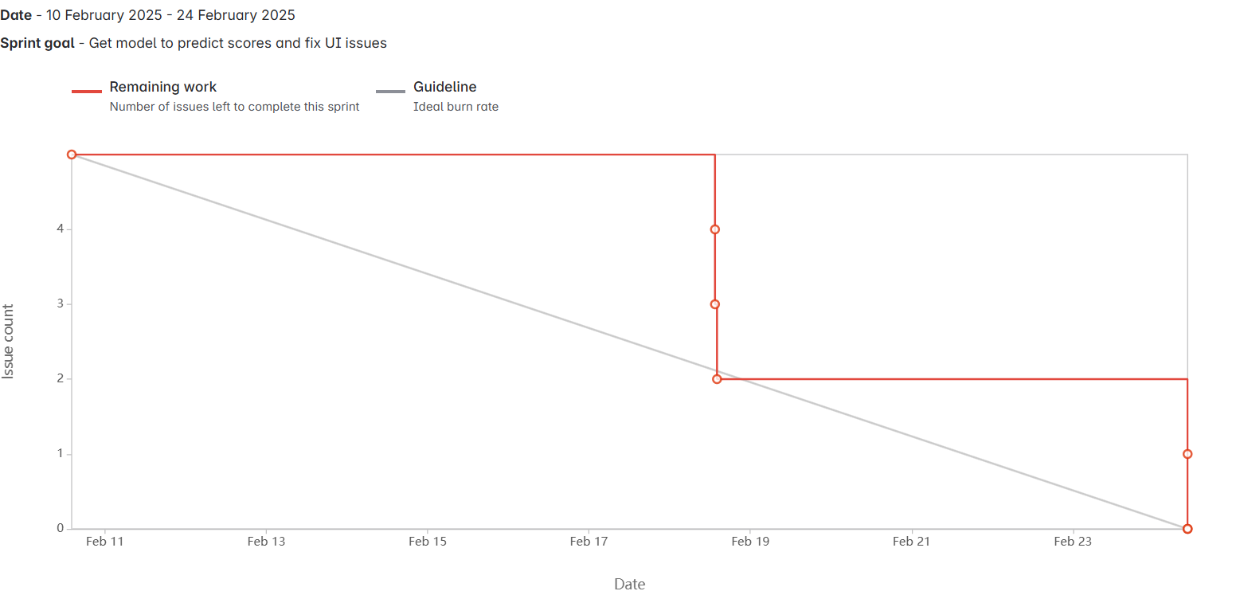
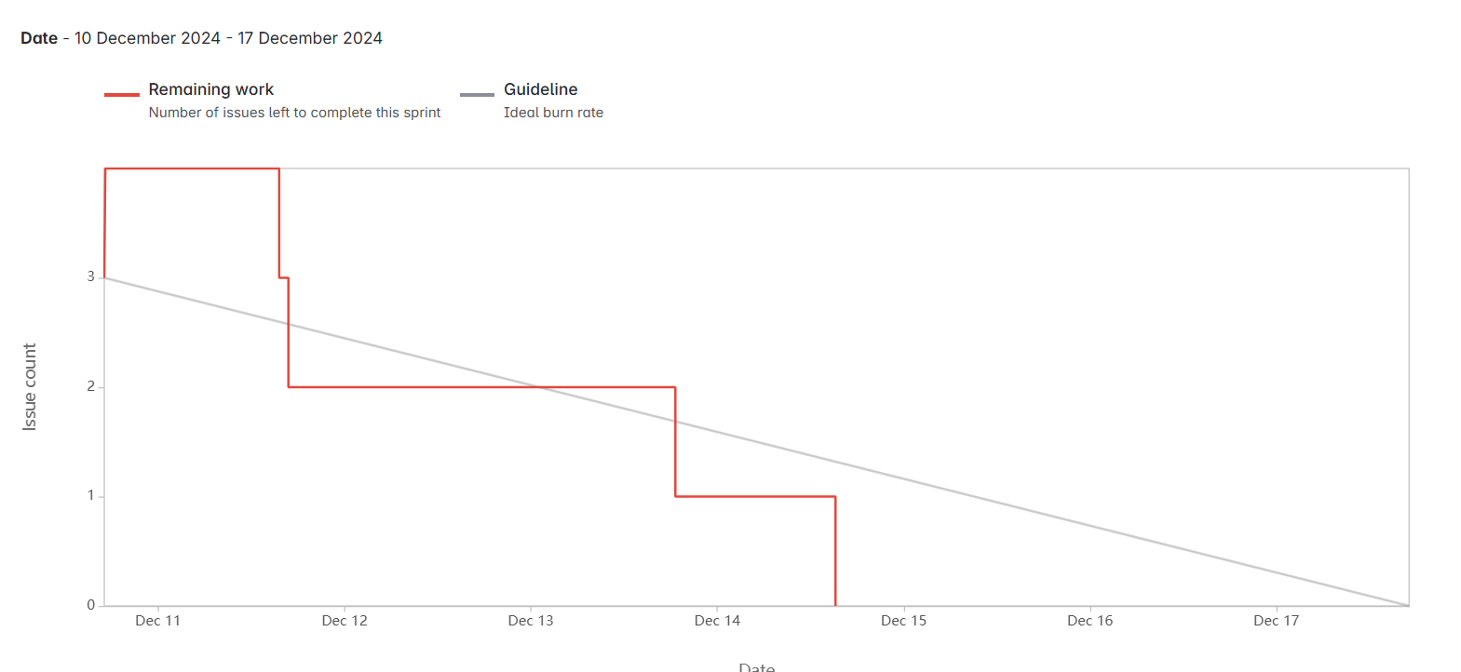
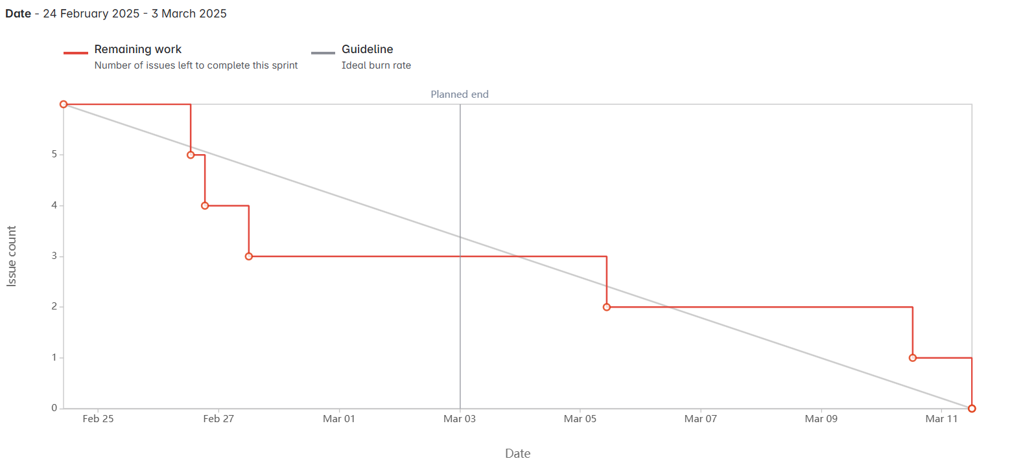
Project Management
Agile Methodology
Two-week sprints
Jira for tracking tasks and progress

Slide 7


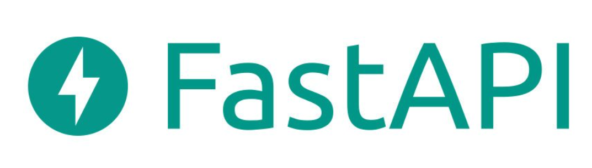


Key Technologies and Libraries
React, FastAPI, TensorFlow, MediaPipe
MongoDB
Tools: GitHub, Google Colab, VS Code

Slide 8

Challenges and Solutions
TensorFlow.js issues → Moved inference server-side
Class imbalances in dataset
Real-time performance optimizations
Secure authentication with JWT cookies

Slide 9

Ethical Considerations
Accessibility focus
No storage of video/image data
Clear, transparent AI usage

Slide 10
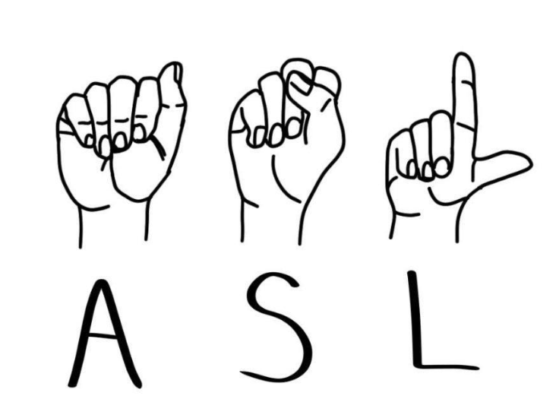
Conclusion
Real-time ASL learning platform achieved
Solid foundation for future expansion
Ready for real-world educational use

